Slide 1
2023 MLCAD FPGA Macro Placement Contest
In Collaboration with UCSD
(The OpenROAD Project & TILOS AI Institute)
Ismail Bustany
Salt Lake City, Utah
09/13/2023
*Updated and shared on 10/06/2023

Slide 2
Agenda
Overview
Benchmark Suite
Design Specifications
Extended Bookshelf Format
3. Evaluation Metrics
4. Participating Teams
1.5 min video presentations
5. Updated Results
Public Benchmark Team Scores
Hidden Benchmark Team Scores
Final Team Rankings
6. Learnings
Awards Ceremony!

Slide 3
Contest Organizing Team
Ismail Bustany*
Meghraj Kalase*
Wuxi Li*
Grigor Gasparyan *
Bodhisatta Pramanik⁺
Andrew Kahng^{+,τ}
Amit Gupta*
Acknowledgments
The TILOS AI Institute, Zhiang Wang, Yuji Kukimoto, Sreevidya Maguluri, Ravishankar Menon, Nima Karimpour-Darav, Mehrdad Eslami, Chaithanya Dudha, Lin Chai, Kai Zhu, Kristin Perry, Cathal McCabe, Mark O Brian, and Vishal Suthar for their helpful remarks, advice, and assistance.
Contest Website
https://github.com/TILOS-AI-Institute/MLCAD-2023-FPGA-Macro-Placement-Contest
*AMD, ⁺ UCSD, ^{τ} TILOS

Slide 4
1. Overview

Slide 5
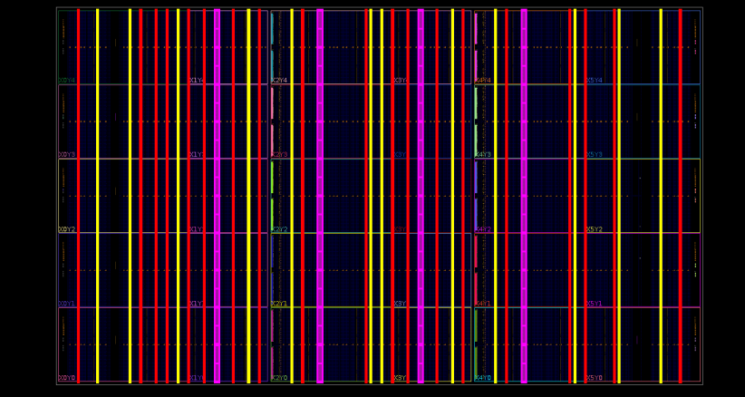
Overview
DSP
BRAM
URAM
FPGA device Layout
Background: Macro placement is NP-hard
For FPGA’s, there are additional challenges:
Discrete and site type columnated nature of the FPGA device layout
Multiple clock domains (typically 1 – 100)
1000’s of macros
Multiple dies
Problem: SOTA algorithms often result in floorplans with routing and timing closure issues
Goal: Spur research for developing ML approaches that supplant the SOTA

Slide 6
Overview
FPGA Device: 16nm single-die UltraScale⁺ xcvu3p
Benchmark suite: 338 synthetically generated designs
Evaluation Metrics: Macro placement runtime, place-and-route flow runtime, and routability
Contest Website: https://github.com/TILOS-AI-Institute/MLCAD-2023-FPGA-Macro-Placement-Contest

Slide 7
2. Benchmark Suite

Slide 8
Benchmark Suite
Netlists generated synthetically
Varying levels of difficulty
Rent’s exponent (0.65, 0.67, 0.7, 0.72)
#clocks (1, 16, 24, 30, 34, 38)
%utilization
LUTs (70, 73, 76, 79, 82, 84)
FFs (38, 40, 42, 43, 45, 47)
DSP, BRAM (80, 82, 84, 86, 88, 90)
URAM’s (65, 67, 70, 72)
cascaded macro shapes (5, 30, and 60 tall)
Non-timing-driven
140 Publicly released designs (1, 24, 30, and 38 clocks),
Download from https://github.com/TILOS-AI-Institute/MLCAD-2023-FPGA-Macro-Placement-Contest/blob/main/Benchmark_Suite/Download_Benchmark_Suite.md
Various bug fixes published on https://github.com/TILOS-AI-Institute/MLCAD-2023-FPGA-Macro-Placement-Contest/blob/main/Documentation/FAQ.md
198 hidden designs (1, 16, 24, 30, 34, and 38 clocks)
To be released after this Workshop

Slide 9
Sample Netlist Specifications – 1 Clock
Design | LUT% | FF% | RAMB% | DSP% | Rent | # Clocks | Runtime (s) | Notes
Design_409 | 70 | 38 | 80 | 80 | 0.67 | 1 | 2035 | No tall BRM/ DSP/ URAM/ Carries
Design_410 | 70 | 38 | 80 | 80 | 0.67 | 1 | 2170 | With 2 instances each of semi tall DSP and BRAM
Design_411 | 70 | 38 | 80 | 80 | 0.67 | 1 | 2783 | With 4 instances each of tall DSP and BRAM
Design_412 | 70 | 38 | 80 | 80 | 0.72 | 1 | 3269 | No tall BRM/ DSP/ URAM/ Carries
Design_413 | 70 | 38 | 80 | 80 | 0.72 | 1 | 2715 | With 2 instances each of semi tall DSP and BRAM
Design_414 | 70 | 38 | 80 | 80 | 0.72 | 1 | 3846 | With 4 instances each of tall DSP and BRAM
Design_415 | 73 | 40 | 82 | 82 | 0.67 | 1 | 3516 | No tall BRM/ DSP/ URAM/ Carries
Design_416 | 73 | 40 | 82 | 82 | 0.67 | 1 | 3067 | With 2 instances each of semi tall DSP and BRAM
Design_417 | 73 | 40 | 82 | 82 | 0.67 | 1 | 3621 | With 4 instances each of tall DSP and BRAM
Design_418 | 73 | 40 | 82 | 82 | 0.72 | 1 | 3353 | No tall BRM/ DSP/ URAM/ Carries
Design_419 | 73 | 40 | 82 | 82 | 0.72 | 1 | 3312 | With 2 instances each of semi tall DSP and BRAM
Design_420 | 73 | 40 | 82 | 82 | 0.72 | 1 | 4310 | With 4 instances each of tall DSP and BRAM
Design_421 | 76 | 42 | 84 | 84 | 0.67 | 1 | 3028 | No tall BRM/ DSP/ URAM/ Carries
Design_422 | 76 | 42 | 84 | 84 | 0.67 | 1 | 3021 | With 2 instances each of semi tall DSP and BRAM
Design_423 | 76 | 42 | 84 | 84 | 0.67 | 1 | 3850 | With 4 instances each of tall DSP and BRAM
Design_424 | 76 | 42 | 84 | 84 | 0.72 | 1 | 3398 | No tall BRM/ DSP/ URAM/ Carries
Design_425 | 76 | 42 | 84 | 84 | 0.72 | 1 | 4972 | With 2 instances each of semi tall DSP and BRAM
Design_426 | 76 | 42 | 84 | 84 | 0.72 | 1 | 4564 | With 4 instances each of tall DSP and BRAM
Design_427 | 79 | 43 | 86 | 86 | 0.67 | 1 | 3144 | No tall BRM/ DSP/ URAM/ Carries
Design_428 | 79 | 43 | 86 | 86 | 0.67 | 1 | 3469 | With 2 instances each of semi tall DSP and BRAM
Design_429 | 79 | 43 | 86 | 86 | 0.67 | 1 | 2573 | With 4 instances each of tall DSP and BRAM
Design_430 | 79 | 43 | 86 | 86 | 0.72 | 1 | 13027 | No tall BRM/ DSP/ URAM/ Carries
Design_431 | 79 | 43 | 86 | 86 | 0.72 | 1 | 4624 | With 2 instances each of semi tall DSP and BRAM
Design_432 | 79 | 43 | 86 | 86 | 0.72 | 1 | 2937 | With 4 instances each of tall DSP and BRAM
Design_433 | 82 | 45 | 88 | 88 | 0.67 | 1 | 3541 | No tall BRM/ DSP/ URAM/ Carries
Design_434 | 82 | 45 | 88 | 88 | 0.67 | 1 | 3316 | With 2 instances each of semi tall DSP and BRAM
Design_435 | 82 | 45 | 88 | 88 | 0.67 | 1 | 4095 | With 4 instances each of tall DSP and BRAM
Design_436 | 82 | 45 | 88 | 88 | 0.72 | 1 | 4342 | No tall BRM/ DSP/ URAM/ Carries
Design_437 | 82 | 45 | 88 | 88 | 0.72 | 1 | 4573 | With 2 instances each of semi tall DSP and BRAM
Design_438 | 82 | 45 | 88 | 88 | 0.72 | 1 | 6323 | With 4 instances each of tall DSP and BRAM
Design_439 | 84 | 47 | 90 | 90 | 0.67 | 1 | 3327 | No tall BRM/ DSP/ URAM/ Carries
Design_440 | 84 | 47 | 90 | 90 | 0.67 | 1 | 3376 | With 2 instances each of semi tall DSP and BRAM
Design_441 | 84 | 47 | 90 | 90 | 0.67 | 1 | 3728 | With 4 instances each of tall DSP and BRAM
Design_442 | 84 | 47 | 90 | 90 | 0.72 | 1 | 2105 | No tall BRM/ DSP/ URAM/ Carries
Design_443 | 84 | 47 | 90 | 90 | 0.72 | 1 | 3604 | With 2 instances each of semi tall DSP and BRAM
Design_444 | 84 | 47 | 90 | 90 | 0.72 | 1 | 3504 | With 4 instances each of tall DSP and BRAM
Design | LUT% | FF% | RAMB% | DSP% | Rent | # Clocks | Runtime (s) | Notes
Design_373 | 70 | 38 | 80 | 80 | 0.67 | 38 | 4681 | No tall BRM/ DSP/ URAM/ Carries
Design_374 | 70 | 38 | 80 | 80 | 0.67 | 38 | 4580 | With 2 instances each of semi tall DSP and BRAM
Design_375 | 70 | 38 | 80 | 80 | 0.67 | 38 | 5082 | With 4 instances each of tall DSP and BRAM
Design_376 | 70 | 38 | 80 | 80 | 0.72 | 38 | 7635 | No tall BRM/ DSP/ URAM/ Carries
Design_377 | 70 | 38 | 80 | 80 | 0.72 | 38 | 4393 | With 2 instances each of semi tall DSP and BRAM
Design_378 | 70 | 38 | 80 | 80 | 0.72 | 38 | 9484 | With 4 instances each of tall DSP and BRAM
Design_379 | 73 | 40 | 82 | 82 | 0.67 | 38 | 3619 | No tall BRM/ DSP/ URAM/ Carries
Design_380 | 73 | 40 | 82 | 82 | 0.67 | 38 | 3123 | With 2 instances each of semi tall DSP and BRAM
Design_381 | 73 | 40 | 82 | 82 | 0.67 | 38 | 4886 | With 4 instances each of tall DSP and BRAM
Design_382 | 73 | 40 | 82 | 82 | 0.72 | 38 | 6874 | No tall BRM/ DSP/ URAM/ Carries
Design_383 | 73 | 40 | 82 | 82 | 0.72 | 38 | 4502 | With 2 instances each of semi tall DSP and BRAM
Design_384 | 73 | 40 | 82 | 82 | 0.72 | 38 | 6578 | With 4 instances each of tall DSP and BRAM
Design_385 | 76 | 42 | 84 | 84 | 0.67 | 38 | 5126 | No tall BRM/ DSP/ URAM/ Carries
Design_386 | 76 | 42 | 84 | 84 | 0.67 | 38 | 4474 | With 2 instances each of semi tall DSP and BRAM
Design_387 | 76 | 42 | 84 | 84 | 0.67 | 38 | 5464 | With 4 instances each of tall DSP and BRAM
Design_388 | 76 | 42 | 84 | 84 | 0.72 | 38 | 5591 | No tall BRM/ DSP/ URAM/ Carries
Design_389 | 76 | 42 | 84 | 84 | 0.72 | 38 | 16205 | With 2 instances each of semi tall DSP and BRAM
Design_390 | 76 | 42 | 84 | 84 | 0.72 | 38 | 6680 | With 4 instances each of tall DSP and BRAM
Design_391 | 79 | 43 | 86 | 86 | 0.67 | 38 | 4833 | No tall BRM/ DSP/ URAM/ Carries
Design_392 | 79 | 43 | 86 | 86 | 0.67 | 38 | 5460 | With 2 instances each of semi tall DSP and BRAM
Design_393 | 79 | 43 | 86 | 86 | 0.67 | 38 | 5089 | With 4 instances each of tall DSP and BRAM
Design_394 | 79 | 43 | 86 | 86 | 0.72 | 38 | 7501 | No tall BRM/ DSP/ URAM/ Carries
Design_395 | 79 | 43 | 86 | 86 | 0.72 | 38 | 7339 | With 2 instances each of semi tall DSP and BRAM
Design_396 | 79 | 43 | 86 | 86 | 0.72 | 38 | 6416 | With 4 instances each of tall DSP and BRAM
Design_397 | 82 | 45 | 88 | 88 | 0.67 | 38 | 3496 | No tall BRM/ DSP/ URAM/ Carries
Design_398 | 82 | 45 | 88 | 88 | 0.67 | 38 | 4707 | With 2 instances each of semi tall DSP and BRAM
Design_399 | 82 | 45 | 88 | 88 | 0.67 | 38 | 4710 | With 4 instances each of tall DSP and BRAM
Design_400 | 82 | 45 | 88 | 88 | 0.72 | 38 | 5705 | No tall BRM/ DSP/ URAM/ Carries
Design_401 | 82 | 45 | 88 | 88 | 0.72 | 38 | 6729 | With 2 instances each of semi tall DSP and BRAM
Design_402 | 82 | 45 | 88 | 88 | 0.72 | 38 | 5856 | With 4 instances each of tall DSP and BRAM
Design_403 | 84 | 47 | 90 | 90 | 0.67 | 38 | 5910 | No tall BRM/ DSP/ URAM/ Carries
Design_404 | 84 | 47 | 90 | 90 | 0.67 | 38 | 5397 | With 2 instances each of semi tall DSP and BRAM
Design_405 | 84 | 47 | 90 | 90 | 0.67 | 38 | 4051 | With 4 instances each of tall DSP and BRAM
Design_406 | 84 | 47 | 90 | 90 | 0.72 | 38 | 4941 | No tall BRM/ DSP/ URAM/ Carries
Design_407 | 84 | 47 | 90 | 90 | 0.72 | 38 | 6277 | With 2 instances each of semi tall DSP and BRAM
Design_408 | 84 | 47 | 90 | 90 | 0.72 | 38 | 6020 | With 4 instances each of tall DSP and BRAM

Slide 10
Sample Netlist Specifications – 38 Clocks
Design | LUT% | FF% | RAMB% | DSP% | Rent | # Clocks | Runtime (s) | Notes
Design_373 | 70 | 38 | 80 | 80 | 0.67 | 38 | 4681 | No tall BRM/ DSP/ URAM/ Carries
Design_374 | 70 | 38 | 80 | 80 | 0.67 | 38 | 4580 | With 2 instances each of semi tall DSP and BRAM
Design_375 | 70 | 38 | 80 | 80 | 0.67 | 38 | 5082 | With 4 instances each of tall DSP and BRAM
Design_376 | 70 | 38 | 80 | 80 | 0.72 | 38 | 7635 | No tall BRM/ DSP/ URAM/ Carries
Design_377 | 70 | 38 | 80 | 80 | 0.72 | 38 | 4393 | With 2 instances each of semi tall DSP and BRAM
Design_378 | 70 | 38 | 80 | 80 | 0.72 | 38 | 9484 | With 4 instances each of tall DSP and BRAM
Design_379 | 73 | 40 | 82 | 82 | 0.67 | 38 | 3619 | No tall BRM/ DSP/ URAM/ Carries
Design_380 | 73 | 40 | 82 | 82 | 0.67 | 38 | 3123 | With 2 instances each of semi tall DSP and BRAM
Design_381 | 73 | 40 | 82 | 82 | 0.67 | 38 | 4886 | With 4 instances each of tall DSP and BRAM
Design_382 | 73 | 40 | 82 | 82 | 0.72 | 38 | 6874 | No tall BRM/ DSP/ URAM/ Carries
Design_383 | 73 | 40 | 82 | 82 | 0.72 | 38 | 4502 | With 2 instances each of semi tall DSP and BRAM
Design_384 | 73 | 40 | 82 | 82 | 0.72 | 38 | 6578 | With 4 instances each of tall DSP and BRAM
Design_385 | 76 | 42 | 84 | 84 | 0.67 | 38 | 5126 | No tall BRM/ DSP/ URAM/ Carries
Design_386 | 76 | 42 | 84 | 84 | 0.67 | 38 | 4474 | With 2 instances each of semi tall DSP and BRAM
Design_387 | 76 | 42 | 84 | 84 | 0.67 | 38 | 5464 | With 4 instances each of tall DSP and BRAM
Design_388 | 76 | 42 | 84 | 84 | 0.72 | 38 | 5591 | No tall BRM/ DSP/ URAM/ Carries
Design_389 | 76 | 42 | 84 | 84 | 0.72 | 38 | 16205 | With 2 instances each of semi tall DSP and BRAM
Design_390 | 76 | 42 | 84 | 84 | 0.72 | 38 | 6680 | With 4 instances each of tall DSP and BRAM
Design_391 | 79 | 43 | 86 | 86 | 0.67 | 38 | 4833 | No tall BRM/ DSP/ URAM/ Carries
Design_392 | 79 | 43 | 86 | 86 | 0.67 | 38 | 5460 | With 2 instances each of semi tall DSP and BRAM
Design_393 | 79 | 43 | 86 | 86 | 0.67 | 38 | 5089 | With 4 instances each of tall DSP and BRAM
Design_394 | 79 | 43 | 86 | 86 | 0.72 | 38 | 7501 | No tall BRM/ DSP/ URAM/ Carries
Design_395 | 79 | 43 | 86 | 86 | 0.72 | 38 | 7339 | With 2 instances each of semi tall DSP and BRAM
Design_396 | 79 | 43 | 86 | 86 | 0.72 | 38 | 6416 | With 4 instances each of tall DSP and BRAM
Design_397 | 82 | 45 | 88 | 88 | 0.67 | 38 | 3496 | No tall BRM/ DSP/ URAM/ Carries
Design_398 | 82 | 45 | 88 | 88 | 0.67 | 38 | 4707 | With 2 instances each of semi tall DSP and BRAM
Design_399 | 82 | 45 | 88 | 88 | 0.67 | 38 | 4710 | With 4 instances each of tall DSP and BRAM
Design_400 | 82 | 45 | 88 | 88 | 0.72 | 38 | 5705 | No tall BRM/ DSP/ URAM/ Carries
Design_401 | 82 | 45 | 88 | 88 | 0.72 | 38 | 6729 | With 2 instances each of semi tall DSP and BRAM
Design_402 | 82 | 45 | 88 | 88 | 0.72 | 38 | 5856 | With 4 instances each of tall DSP and BRAM
Design_403 | 84 | 47 | 90 | 90 | 0.67 | 38 | 5910 | No tall BRM/ DSP/ URAM/ Carries
Design_404 | 84 | 47 | 90 | 90 | 0.67 | 38 | 5397 | With 2 instances each of semi tall DSP and BRAM
Design_405 | 84 | 47 | 90 | 90 | 0.67 | 38 | 4051 | With 4 instances each of tall DSP and BRAM
Design_406 | 84 | 47 | 90 | 90 | 0.72 | 38 | 4941 | No tall BRM/ DSP/ URAM/ Carries
Design_407 | 84 | 47 | 90 | 90 | 0.72 | 38 | 6277 | With 2 instances each of semi tall DSP and BRAM
Design_408 | 84 | 47 | 90 | 90 | 0.72 | 38 | 6020 | With 4 instances each of tall DSP and BRAM

Slide 11
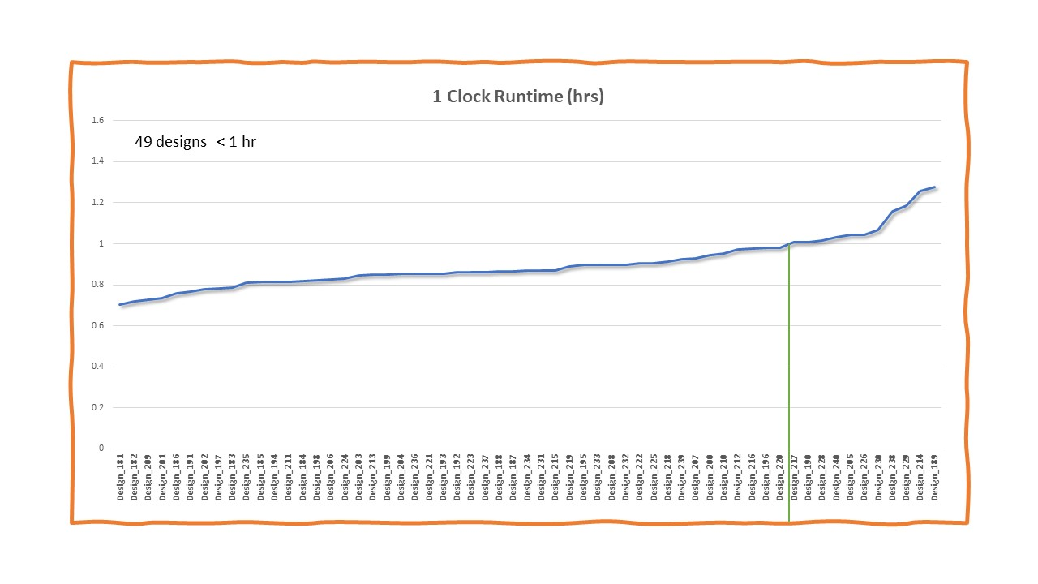
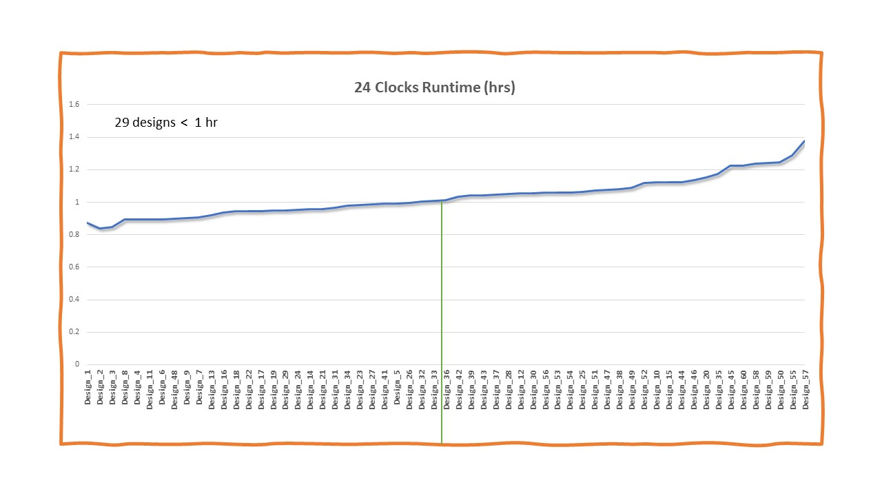
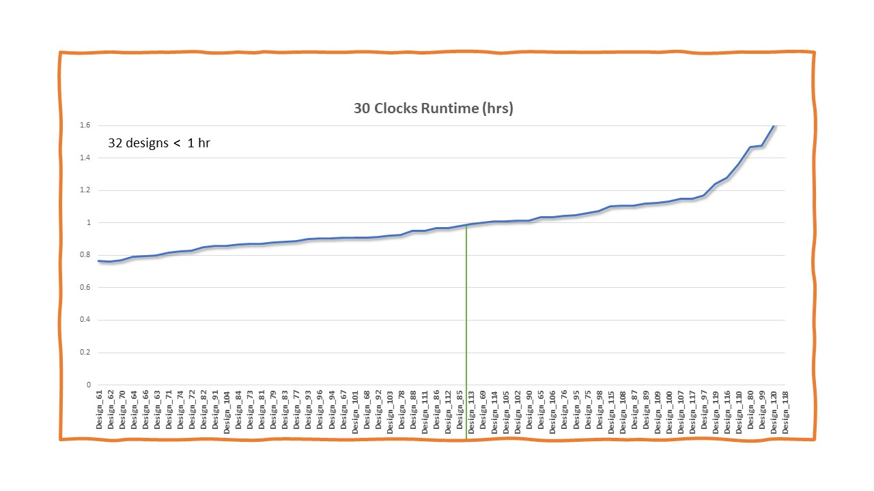
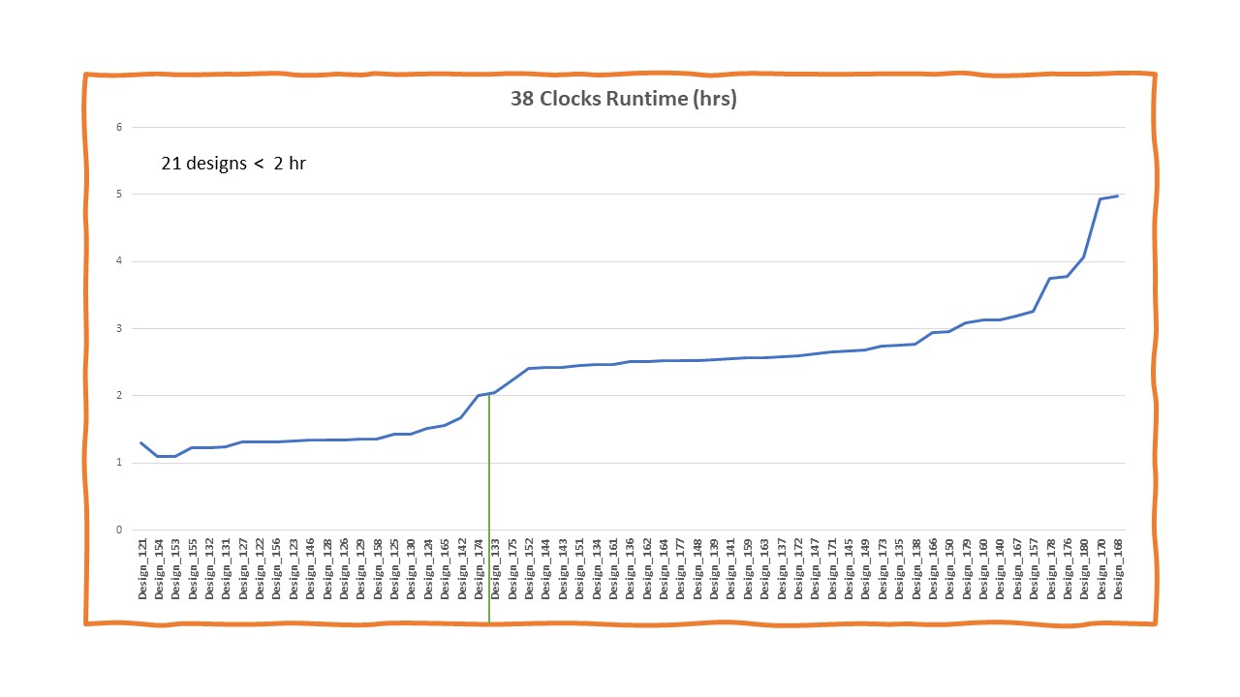
Sample Baseline Place-and-Route Flow Runtimes

Slide 12
Benchmark Suite Extended Bookshelf Format
 | File name | Description
1. | design.nodes | Specifies placeable instances in the netlist (in Bookshelf format)
2. | design.nets | Specifies the set of nets in the netlist (in Bookshelf format)
3. | design.lib | Specifies the cell library for placeable objects
4. | design.pl | Specifies the site locations of the macros including cascade macro shape instances, I/O, and fixed objects. This file only contains locations of fixed instances (IBUF/OBUF/BUFGCE etc.). Your task is to supply the locations of the placeable macro instances. Valid locations for macro (and cascade shape) instances are prescribed in the design.scl file.
5. | sample.pl | Specifies a macro placement sample reference solution.
6. | design.scl | Extended from the original Bookshelf format to represent xcvu3p device layout and permissible site locations for all placeable object types (please refer to Figure 1).
7. | design.cascade_shape | Specifies the types of placeable cascade macro shapes.
8. | design.cascade_shape_instances | Specifies the netlist instances of cascade macro shapes (not provided if no cascade shapes are present in the netlist).
9. | design.regions | Specifies the box region constraints imposed on placeable objects.
10. | design.dcp | This file contains the synthesized netlist checkpoint that is required as an input by the Vivado© executable.
11. | vivado_pnr.tcl | A TCL script to place and route a netlist using the Vivado© flow leveraging the input macro placement solution.
12. | design.macros | The names of placeable macro blocks in this design.
For details please visit: https://github.com/TILOS-AI-Institute/MLCAD-2023-FPGA-Macro-Placement-Contest

Slide 13
3. Evaluation Metrics

Slide 14

Evaluation Metrics
Per Design:
Score = runtime(macro placement) x runtime(place-and-route flow) x routability
runtime(macro placement) = 1 + $\max\left(0, {macroplacement_{runtime}}_{i}−10\right)$(in mins)
Penalty only incurred if macro placement runtime > 10 mins
runtime (place-and-route flow) = runtime of place-and-route flow in hours
Per Team:
Final Team Score = Weighted geometric mean of all design scores
Lower is better

Slide 15

Evaluation Metrics - Interconnect Tile Grid
Interconnect tile grid
Tile grid where device interconnect resources are defined
Interconnect tile grid routing resources:
Short: wires spanning 1-4 tiles
Long: wires spanning 8 or more tiles
North
West
INT Tile
East
South

Slide 16
Evaluation Metrics - What is routing congestion?
Interconnect tile grid
Congestion = Oversubscription of interconnect routing resources
As the demand region grows, the router struggles to find a feasible solution

Slide 17
Evaluation Metrics - Interconnect Tile Congestion Types
Congestion is typed by interconnect length and wire direction (N, S, E, W)
Short congestion
Typically caused by “closely clustered cell placements”
Potentially leads to routability issues
Long congestion
Typically caused by “long spread-out cell placements”
Potentially leads to timing and routability issues
Global congestion
Aggregation of short and long congestion

Slide 18

Evaluation Metrics – Routability Score Per Design
Routability = initial_routing_score x final_routing_score
initial_routing_score:
________________________________________________________________________
| Wire | Global Congestion | Long Congestion | Short Congestion |
| Direction |___________________|___________________|___________________|
| | Size | % Tiles | Size | % Tiles | Size | % Tiles |
|___________|________|__________|________|__________|________|__________|
| NORTH| 32x32| 4.79| 128x128| 20.18| 4x4| 1.33|
|___________|________|__________|________|__________|________|__________|
| SOUTH| 16x16| 3.87| 128x128| 20.03| 4x4| 0.96|
|___________|________|__________|________|__________|________|__________|
| EAST| 32x32| 5.22| 64x64| 18.83| 8x8| 3.28|
|___________|________|__________|________|__________|________|__________|
| WEST| 32x32| 8.29| 128x128| 23.46| 4x4| 4.50|
|___________|________|__________|________|__________|________|__________|
Congestion level 4 means there is 16 x16 interconnect tile grid that is congested
We only penalize congestion levels > 3
initial routing score = 1 + $\sum_{i=1}^{4}{{[max⁡(0, {short level}_{i}−3)}^{2}+}$ ${max⁡(0, {global level}_{i}−3)}^{2}]$
final_routing_score = No. final router outer iterations
Unplaceable and unroutable designs are penalized with a score of 500

Slide 19
4. Participating Teams

Slide 20
Participating Teams
19 participants – 3@Canada, 6@China, 2@Hong Kong, 1@India, 1@Korea, 1@Taiwan, and 5@USA
8 finalists (6 of which are competitive)
Team | University | Professor | Members
TAMU | Texas A & M | Jiang Hu | Hailiang Hu, Donghao Fang, Yishuang Lin
MPKU | Peking University | Yibo Lin | Jing Mai, Jiarui Wang, Xun Jiang, Zizheng Guo, Yifan Chen
CUMPLE | CUHK | Evangeline F.Y. Young | Qin Luo, Xinshi Zang, Qijing Wang, Fangzhou Wang
Pomelo | Nanjing University of Posts and Telecommunications | Jieming Yin | Hao Wu, Linhua Tao
DAG-MP | Shanghai Jiao Tong University | Xinfei Guo | Xiaotian Zhao, Tianju Wang, Yuia Sun, Xinfei Guo
MacroM | Nirma University | Manish I. Patel | Jaydeep Solanki, Jugal Gandhi, Pranav Kotadia, Riththika Sukanandan
MacroD | Pohang University | Seokhyeong Kang | Junseok Hur, Seongbin Kwon, Jaeseung Lee, JoonSeok Kim, Kyumin cho
IMR | Not provided | Liang Yi | Fu Mingjian, Ma Jimiao
SEU | Southeast University | Ziran Zhu, Jun Yang, Jianli Chen | Hao Gu, Jian Gu, Yuxian Yue
GoFish | Georgia Tech | Callie Hao | Stefan Abi-Karam
EFM | University of Calgary | Laleh Behjat | Erfan Aghaeekiasaraee
BO | University of Illinois-Urbana Champaign | Elyse Rosenbaum | Michael Molter
Duke | Duke University | Yiran Chen | Guangle i Zhou, Jingyu Pan, Chen-Chia Chang, Yiran Chen
UBCP | UBC | Steven Wilton | Andrew Gunter, Martin Chua, Nikhil Ghanathe, Elmira Nezamfar, Roozmehr Jalilian
GD | Dalian University of Technology | Yan Xing, Weijun Li | Yihao Huang, Juming Xian, Zhihao Chen, Wenhao Liu, Zhongnuo Wang
MacroW | Simon Fraser University | Behnam Ghavami and Lesley Shanon | Mani Sadati, Mohammad Sahidzade, and Saba Jahan-Tighi.
CUMP | CUHK | Bei Yu, Tinghuan Chen | Yuan Pu, Hongduo Liu, Mingjun Li, Lanchen Zou
UTDA UT Austin |  | David Pan | Zhili Xiong, Rachel S. Rajarathnam,Zhixing Jiang, Hanqing Zhu
NTHU | National Tsing Hua University | Ting-Chi Wang, | Woei-Haur Hong, Hsu Chi, Tung-Yeh Wu, Yung-Hsuan Fu, Chia-en Lu, Hao-Wei Chen

Slide 21
8 Finalists
Team | University | Professor | Members
TAMU | Texas A & M | Jiang Hu | Hailiang Hu, Donghao Fang, Yishuang Lin
MPKU | Peking University | Yibo Lin | Jing Mai, Jiarui Wang, Xun Jiang, Zizheng Guo, Yifan Chen
CUMPLE | CUHK | Evangeline F.Y. Young | Qin Luo, Xinshi Zang, Qijing Wang, Fangzhou Wang
SEU | Southeast University | Ziran Zhu, Jun Yang, Jianli Chen | Hao Gu, Jian Gu, Yuxian Yue
UBCP | UBC | Steven Wilton | Andrew Gunter, Martin Chua, Nikhil Ghanathe, Elmira Nezamfar, Roozmehr Jalilian
UTDA UT Austin |  | David Pan | Zhili Xiong, Rachel S. Rajarathnam,Zhixing Jiang, Hanqing Zhu
NTHU | National Tsing Hua University | Ting-Chi Wang, | Woei-Haur Hong, Hsu Chi, Tung-Yeh Wu, Yung-Hsuan Fu, Chia-en Lu, Hao-Wei Chen
CUMP | CUHK | Bei Yu, Tinghuan Chen | Yuan Pu, Hongduo Liu, Mingjun Li, Lanchen Zou

Slide 22
1.5 min Team Video Presentations

Slide 23
5. Updated Results

Slide 24
Results – Public Benchmark Macro Placement Runtimes
Runtime (min)
Runtime Summary (min)
Metric | mpku | seu | utda | tamu | cumple | cump
Average | 4.80 | 2.20 | 5.62 | 7.92 | 8.02 | 0.44
GeoMean | 4.80 | 2.16 | 5.55 | 7.54 | 7.96 | 0.43
Stddev | 0.15 | 0.43 | 1.07 | 2.09 | 1.02 | 0.06
Max | 5.08 | 3.30 | 12.29 | 9.66 | 10.87 | 0.58
5x-20x fastest!
Except for 4 runs, all macro placers ran under 10-min threshold, triggering no runtime penalty

Slide 25
Results – Public Benchmark Place-and-Route Runtimes
Runtime (hrs)
Runtime Summary (hr)
Metric | mpku | seu | utda | tamu | cumple | cump
Average | 0.55 | 0.55 | 0.58 | 0.62 | 0.59 | 0.76
GeoMean | 0.53 | 0.54 | 0.56 | 0.56 | 0.58 | 0.68
Stddev | 0.16 | 0.13 | 0.25 | 0.39 | 0.16 | 0.46
mpku and seu had the slowest runtimes overall

Slide 26
Results - Public Benchmark Team Scores
Team Scores
Score Summary
Design | mpku | seu | utda | tamu | cumple | cump
Average | 5.716 | 3.675 | 4.204 | 10.775 | 6.188 | 30.603
GeoMean | 3.023 | 2.233 | 2.120 | 3.593 | 3.029 | 6.650
Stddev | 9.181 | 6.495 | 16.236 | 26.859 | 10.648 | 63.609

Slide 27
Results - Public Benchmark Team Scores
Design | mpku | seu | utda | tamu | cumple | cump
Design_10 | 9.394 | 1.564 | 1.658 | 1.585 | 1.604 | 17.689
Design_100 | 5.608 | 1.650 | 1.749 | 3.617 | 10.007 | 26.253
Design_101 | 1.539 | 1.615 | 1.722 | 1.541 | 1.593 | 3.930
Design_102 | 1.566 | 1.598 | 1.728 | 1.553 | 1.600 | 1.768
Design_105 | 3.495 | 1.602 | 1.723 | 1.578 | 1.620 | 1.821
Design_106 | 11.570 | 9.825 | 1.769 | 1.640 | 18.128 | 34.839
Design_107 | 5.446 | 1.648 | 1.770 | 7.734 | 1.738 | 14.284
Design_11 | 1.501 | 1.550 | 1.663 | 1.487 | 1.528 | 1.696
Design_110 | 11.795 | 9.706 | 1.704 | 39.550 | 18.957 | 1.538
Design_111 | 1.515 | 1.551 | 1.627 | 1.564 | 1.556 | 1.558
Design_112 | 1.534 | 1.553 | 1.633 | 1.580 | 1.601 | 1.548
Design_115 | 1.538 | 1.538 | 1.648 | 1.629 | 1.580 | 1.553
Design_116 | 31.048 | 24.725 | 28.692 | 69.927 | 30.847 | 1.548
Design_117 | 27.036 | 3.640 | 5.877 | 37.491 | 87.442 | 1.548
Design_12 | 1.453 | 1.451 | 1.541 | 1.467 | 1.475 | 1.553
Design_120 | 14.949 | 1.732 | 10.389 | 66.195 | 23.392 | 1.548
Design_121 | 1.447 | 1.590 | 1.469 | 1.465 | 1.439 | 1.658
Design_122 | 1.443 | 1.583 | 1.481 | 1.469 | 1.424 | 1.649
Design_125 | 1.456 | 1.604 | 1.490 | 1.486 | 3.314 | 1.678
Design_126 | 3.280 | 1.646 | 1.532 | 3.390 | 3.258 | 30.048
Design_127 | 3.347 | 1.635 | 3.370 | 1.573 | 1.493 | 3.960
Design_130 | 1.540 | 1.669 | 1.542 | 3.436 | 1.489 | 1.751
Design_131 | 1.451 | 1.615 | 1.475 | 1.478 | 1.438 | 1.682
Design_132 | 1.443 | 1.606 | 1.508 | 1.497 | 1.458 | 1.700
Design_135 | 1.503 | 1.508 | 1.585 | 1.490 | 1.579 | 10.121
Design_136 | 13.441 | 1.623 | 9.773 | 3.517 | 9.629 | 113.445
Design_137 | 17.637 | 9.268 | 1.629 | 40.590 | 28.005 | 209.770
Design_140 | 24.945 | 1.601 | 1.662 | 10.467 | 36.532 | 137.447
Design_141 | 1.500 | 1.516 | 1.598 | 1.499 | 1.556 | 9.415
Design_142 | 1.520 | 1.524 | 1.596 | 1.464 | 1.545 | 1.583
Design_145 | 1.515 | 1.545 | 1.584 | 3.345 | 1.578 | 1.639
Design_147 | 13.240 | 5.487 | 1.623 | 14.402 | 5.543 | 48.356
Design_15 | 1.431 | 1.487 | 1.475 | 1.438 | 1.595 | 1.522
Design_150 | 7.796 | 1.607 | 3.516 | 10.111 | 18.998 | 36.329
Design_151 | 3.241 | 1.516 | 1.506 | 1.467 | 1.637 | 9.914
Design_152 | 1.488 | 1.501 | 1.486 | 1.491 | 1.643 | 1.614
Design_155 | 1.500 | 1.542 | 1.538 | 1.514 | 1.669 | 3.630
Design_156 | 39.373 | 18.954 | 13.666 | 6.133 | 20.357 | 47.375
Design_16 | 5.151 | 1.526 | 1.502 | 21.065 | 3.685 | 30.389
Design_160 | 23.751 | 1.702 | 3.658 | 35.544 | 35.890 | 218.866
Design_161 | 1.513 | 1.526 | 1.588 | 1.494 | 1.528 | 1.549
Design_162 | 1.487 | 1.518 | 1.605 | 1.508 | 1.536 | 1.575
Design_165 | 1.528 | 1.561 | 1.568 | 1.535 | 1.540 | 1.572
Design_166 | 1.653 | 1.597 | 9.866 | 13.407 | 11.496 | 50.339
Design_167 | 30.550 | 3.662 | 3.711 | 53.425 | 24.083 | 186.057
Design_17 | 17.038 | 1.532 | 1.550 | 1.566 | 1.514 | 30.589
Design_170 | 64.344 | 10.218 | 6.082 | 178.838 | 49.504 | 365.959
Design_171 | 3.397 | 1.551 | 1.589 | 1.522 | 1.571 | 3.581
Design_172 | 1.532 | 1.597 | 1.563 | 1.534 | 1.574 | 3.539
Design_175 | 3.393 | 1.601 | 1.544 | 5.484 | 5.485 | 1.583
Design_176 | 20.363 | 32.281 | 14.753 | 219.919 | 19.620 | 316.935
Design_180 | 48.282 | 57.293 | 189.305 | 48.936 | 15.721 | 134.550
Design_181 | 1.382 | 1.450 | 1.409 | 1.365 | 1.408 | 1.413
Design_182 | 1.389 | 1.452 | 1.416 | 1.377 | 1.437 | 1.431
Design | mpku | seu | utda | tamu | cumple | cump
Design_185 | 1.389 | 1.460 | 1.445 | 1.399 | 1.424 | 1.459
Design_186 | 1.442 | 3.268 | 1.440 | 3.113 | 1.462 | 16.139
Design_187 | 4.919 | 4.901 | 5.296 | 26.379 | 16.640 | 92.307
Design_190 | 19.346 | 21.649 | 27.245 | 27.807 | 18.785 | 58.871
Design_191 | 1.531 | 1.414 | 1.496 | 1.415 | 1.429 | 1.423
Design_192 | 1.401 | 1.407 | 1.529 | 1.427 | 1.469 | 1.438
Design_195 | 1.424 | 1.445 | 1.539 | 1.423 | 1.467 | 1.469
Design_196 | 1.540 | 3.142 | 1.540 | 1.450 | 1.479 | 9.382
Design_197 | 3.195 | 3.246 | 9.290 | 5.086 | 10.811 | 171.911
Design_2 | 1.531 | 1.414 | 1.526 | 1.414 | 1.427 | 1.478
Design_20 | 8.942 | 1.486 | 1.511 | 9.026 | 1.531 | 11.499
Design_200 | 1.455 | 1.488 | 3.392 | 5.021 | 6.816 | 28.298
Design_201 | 1.419 | 1.446 | 1.478 | 1.412 | 1.419 | 1.479
Design_202 | 1.404 | 1.428 | 1.478 | 1.409 | 1.449 | 1.496
Design_205 | 1.418 | 1.447 | 1.478 | 1.418 | 1.425 | 3.301
Design_206 | 19.798 | 5.108 | 5.235 | 16.034 | 5.024 | 44.299
Design_207 | 5.687 | 13.018 | 8.971 | 48.760 | 18.461 | 190.535
Design_21 | 1.444 | 1.470 | 1.511 | 1.445 | 1.493 | 1.542
Design_210 | 4.911 | 12.485 | 6.948 | 18.082 | 12.619 | 23.673
Design_211 | 1.475 | 1.433 | 1.469 | 1.402 | 1.458 | 1.517
Design_212 | 1.644 | 1.430 | 1.542 | 1.416 | 1.441 | 1.516
Design_215 | 1.623 | 1.451 | 1.485 | 1.421 | 1.491 | 1.569
Design_216 | 3.378 | 9.815 | 3.375 | 3.242 | 5.041 | 30.289
Design_217 | 1.496 | 1.487 | 1.523 | 5.066 | 8.875 | 22.787
Design_22 | 1.515 | 1.462 | 1.496 | 1.436 | 1.501 | 1.560
Design_220 | 3.078 | 3.263 | 1.518 | 3.205 | 1.502 | 41.852
Design_221 | 1.445 | 1.466 | 1.480 | 1.425 | 1.473 | 3.352
Design_222 | 1.624 | 1.466 | 1.509 | 1.420 | 1.483 | 1.535
Design_225 | 1.634 | 1.485 | 1.495 | 1.420 | 1.507 | 3.396
Design_226 | 5.264 | 13.174 | 1.566 | 5.234 | 9.404 | 45.940
Design_227 | 7.903 | 9.088 | 9.298 | 16.802 | 5.495 | 64.747
Design_230 | 7.877 | 12.727 | 5.290 | 17.079 | 15.354 | 215.774
Design_231 | 1.453 | 1.467 | 1.496 | 1.431 | 1.482 | 1.546
Design_232 | 1.460 | 1.482 | 1.494 | 1.472 | 1.492 | 3.449
Design_235 | 1.448 | 3.286 | 1.550 | 1.472 | 1.557 | 3.409
Design_236 | 9.536 | 9.574 | 5.551 | 31.543 | 11.099 | 286.189
Design_237 | 5.146 | 10.966 | 11.415 | 7.151 | 1.564 | 54.023
Design_240 | 5.856 | 9.061 | 5.458 | 11.210 | 5.610 | 21.923
Design_25 | 1.463 | 1.491 | 1.540 | 1.448 | 1.526 | 1.513
Design_26 | 1.448 | 1.503 | 1.550 | 1.505 | 1.504 | 5.403
Design_27 | 1.502 | 1.505 | 1.571 | 3.326 | 1.532 | 1.631
Design_30 | 3.265 | 1.489 | 1.550 | 1.511 | 1.589 | 3.540
Design_31 | 1.467 | 1.444 | 1.493 | 1.433 | 1.602 | 1.486
Design_32 | 1.471 | 1.493 | 1.515 | 1.451 | 1.586 | 1.483
Design_35 | 1.488 | 1.502 | 1.527 | 1.456 | 1.610 | 1.500
Design_36 | 1.506 | 1.498 | 1.513 | 8.649 | 3.656 | 5.410
Design_37 | 10.629 | 3.424 | 3.421 | 3.298 | 11.368 | 88.915
Design_40 | 11.124 | 1.537 | 1.554 | 10.097 | 9.778 | 42.005
Design_41 | 1.484 | 1.538 | 1.534 | 1.469 | 1.618 | 3.397
Design_42 | 1.502 | 1.514 | 1.522 | 1.486 | 1.638 | 1.510
Design_45 | 1.510 | 1.561 | 1.551 | 1.516 | 1.577 | 1.537
Design_46 | 3.463 | 1.568 | 1.608 | 7.269 | 3.561 | 52.329
Design_47 | 3.402 | 3.502 | 1.584 | 3.336 | 11.190 | 45.233
Design_5 | 1.421 | 1.433 | 1.438 | 1.393 | 1.454 | 1.475
Design | mpku | seu | utda | tamu | cumple | cump
Design_50 | 3.431 | 1.560 | 1.604 | 7.603 | 1.568 | 12.371
Design_51 | 1.487 | 1.528 | 1.553 | 1.476 | 1.514 | 1.528
Design_52 | 1.493 | 1.533 | 1.542 | 1.486 | 1.542 | 1.539
Design_55 | 1.505 | 1.544 | 1.563 | 1.485 | 1.586 | 1.563
Design_56 | 5.269 | 1.585 | 1.593 | 3.535 | 1.678 | 28.156
Design_57 | 16.295 | 3.722 | 3.573 | 5.615 | 3.742 | 153.625
Design_6 | 1.426 | 1.484 | 1.479 | 1.453 | 1.504 | 9.260
Design_60 | 3.511 | 1.627 | 1.629 | 78.819 | 1.621 | 4.000
Design_61 | 1.414 | 1.465 | 1.454 | 1.428 | 1.458 | 1.491
Design_62 | 1.413 | 1.469 | 1.449 | 1.439 | 1.475 | 1.513
Design_65 | 1.422 | 1.482 | 1.459 | 1.433 | 1.512 | 1.486
Design_66 | 3.195 | 1.498 | 1.470 | 8.946 | 9.309 | 11.919
Design_67 | 1.470 | 3.284 | 1.472 | 1.472 | 1.468 | 1.537
Design_7 | 3.221 | 1.472 | 1.434 | 3.286 | 1.454 | 14.108
Design_70 | 8.981 | 3.276 | 1.501 | 3.324 | 8.808 | 9.246
Design_71 | 1.459 | 1.436 | 1.450 | 1.445 | 1.481 | 1.471
Design_72 | 1.496 | 1.456 | 1.452 | 1.466 | 1.453 | 1.495
Design_75 | 1.490 | 1.461 | 1.464 | 1.479 | 1.477 | 1.476
Design_76 | 3.316 | 1.509 | 1.504 | 17.641 | 5.082 | 9.674
Design_77 | 3.297 | 1.514 | 1.488 | 13.185 | 1.539 | 3.598
Design_80 | 3.283 | 1.518 | 1.492 | 9.492 | 5.731 | 68.922
Design_81 | 1.474 | 1.456 | 1.459 | 1.460 | 1.601 | 1.490
Design_82 | 1.437 | 1.455 | 1.461 | 1.467 | 1.650 | 1.528
Design_85 | 1.452 | 1.483 | 1.486 | 1.493 | 1.655 | 1.483
Design_86 | 3.355 | 1.503 | 1.508 | 13.942 | 9.981 | 19.908
Design_87 | 9.489 | 1.524 | 1.499 | 17.587 | 12.621 | 21.771
Design_90 | 3.395 | 1.522 | 1.514 | 15.148 | 1.714 | 10.100
Design_91 | 1.461 | 1.466 | 1.476 | 1.486 | 1.605 | 1.495
Design_92 | 1.445 | 1.465 | 1.490 | 1.464 | 1.644 | 1.509
Design_95 | 1.473 | 1.449 | 1.492 | 1.483 | 1.673 | 3.400
Design_96 | 1.548 | 1.461 | 1.504 | 1.515 | 1.712 | 10.426
Design_97 | 3.305 | 3.295 | 1.539 | 1.578 | 1.751 | 3.638
Score Summary
Metric | mpku | seu | utda | tamu | cumple | cump
Average | 5.716 | 3.675 | 4.204 | 10.775 | 6.188 | 30.603
GeoMean | 3.023 | 2.233 | 2.120 | 3.593 | 3.029 | 6.650
Stddev | 9.181 | 6.495 | 16.236 | 26.859 | 10.648 | c

Slide 28
Results – Hidden* Benchmark Team Scores
Team scores
Score Summary
Metric | mpku | seu | utda | tamu | cumple | cump
Average | 5.859 | 11.100 | 10.933 | 34.448 | 15.380 | 71.529
GeoMean | 2.566 | 2.846 | 2.933 | 5.373 | 3.585 | 10.633
Stddev | 11.028 | 40.166 | 38.691 | 82.058 | 35.956 | 128.078
*Ran on a representative set of 38 designs from the 198 hidden benchmark suite because of runtime constraints

Slide 29
Results – Hidden* Benchmark Team Scores
Design | mpku | seu | utda | tamu | cumple | cump
Design_433 | 5.085 | 3.361 | 1.542 | 5.345 | 1.615 | 5.567
Design_434 | 3.301 | 1.529 | 5.294 | 3.403 | 3.500 | 30.824
Design_436 | 12.209 | 27.974 | 19.707 | 63.946 | 48.640 | 253.753
Design_439 | 1.502 | 1.538 | 1.557 | 1.541 | 1.594 | 3.518
Design_440 | 1.516 | 3.389 | 1.564 | 5.291 | 1.638 | 7.479
Design_443 | 5.085 | 248.059 | 239.319 | 353.023 | 51.947 | 538.871
Design_454 | 3.176 | 1.453 | 1.475 | 3.366 | 3.304 | 3.733
Design_457 | 1.435 | 1.453 | 1.452 | 1.478 | 1.468 | 1.672
Design_460 | 1.485 | 1.510 | 1.468 | 1.531 | 1.514 | 3.735
Design_461 | 1.467 | 1.480 | 1.472 | 3.456 | 3.406 | 57.339
Design_463 | 1.426 | 1.464 | 1.446 | 1.500 | 1.491 | 1.652
Design_464 | 1.448 | 1.478 | 1.562 | 1.627 | 1.522 | 1.625
Design_475 | 1.435 | 1.499 | 1.613 | 1.686 | 1.627 | 1.653
Design_476 | 1.461 | 1.491 | 1.623 | 1.643 | 1.581 | 3.670
Design_478 | 1.534 | 3.476 | 3.678 | 5.857 | 1.635 | 51.462
Design_479 | 25.288 | 30.976 | 20.894 | 43.490 | 41.510 | 240.531
Design_481 | 1.447 | 1.406 | 1.638 | 1.565 | 1.464 | 1.472
Design_487 | 1.449 | 1.461 | 1.675 | 1.558 | 1.451 | 3.270
Design_488 | 1.453 | 1.473 | 1.682 | 1.588 | 1.495 | 1.502
Design_496 | 52.887 | 5.387 | 3.895 | 51.999 | 23.693 | 361.085
Design_497 | 11.271 | 11.983 | 25.720 | 273.807 | 53.318 | 221.208
Design_499 | 1.534 | 1.518 | 1.720 | 1.600 | 1.510 | 1.511
Design_500 | 1.500 | 1.492 | 1.652 | 1.523 | 1.570 | 1.550
Design_502 | 1.605 | 1.567 | 3.771 | 11.316 | 3.480 | 12.852
Design_508 | 30.575 | 3.651 | 25.726 | 33.004 | 185.635 | 285.071
Design_509 | 31.965 | 24.487 | 18.266 | 101.007 | 109.031 | 237.315
Design_511 | 1.558 | 1.546 | 1.740 | 1.559 | 1.47 | 1.603
Design_512 | 1.528 | 1.501 | 1.759 | 1.546 | 1.703 | 3.461
Design_374 | 1.472 | 1.453 | 1.469 | 1.485 | 1.452 | 3.495
Design_380 | 1.452 | 1.480 | 1.484 | 1.472 | 1.473 | 3.347
Design_382 | 1.605 | 13.585 | 5.425 | 269.895 | 9.737 | 237.461
Design_385 | 1.508 | 1.525 | 1.501 | 1.528 | 1.493 | 1.567
Design_386 | 1.512 | 1.528 | 1.517 | 3.348 | 1.496 | 12.305
Design_458 | 1.435 | 1.434 | 1.429 | 1.424 | 1.433 | 3.252
Design_470 | 1.470 | 1.108 | 1.469 | 1.467 | 1.445 | 1.474
Design_473 | 1.532 | 5.207 | 1.528 | 9.002 | 1.509 | 30.603
Design_488 | 1.481 | 1.448 | 1.445 | 1.411 | 1.412 | 1.434
Design_491 | 1.537 | 3.424 | 3.257 | 37.727 | 9.193 | 84.162
Score Summary
Metric | mpku | seu | utda | tamu | cumple | cump
Average | 5.859 | 11.100 | 10.933 | 34.448 | 15.380 | 71.529
GeoMean | 2.566 | 2.846 | 2.933 | 5.373 | 3.585 | 10.633
Stddev | 11.028 | 40.166 | 38.691 | 82.058 | 35.956 | 128.078
*38 representative designs from hidden benchmark suite

Slide 30
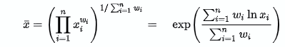
Final Rankings
For each team,
Combined 140 public + 38 hidden scores to have equal contributions to final score
w_{public} = 1
w_{hidden} = 140/38
Final Score = weighted geometric mean (w_{public,} w_{hidden})
Final Team Scores:
Team | Weighted GeoMean | Rank
utda | 2.513 | 1*
seu | 2.516 | 1*
mpku | 2.751 | 2
cumple | 3.605 | 3
Tamu | 4.399 | 4
cump | 8.433 | 5

Slide 31
5. Results with Updated Team MPKU Exec

Slide 32
Results* - Public Benchmark Place-and-Route Runtimes with Updated MPKU exec
P&R Runtime (hrs)
P&R Runtime (hrs)
Runtime Summary
Runtime Summary
Metric | mpku | seu | utda | tamu | cumple | cump
Average | 0.55 | 0.55 | 0.58 | 0.62 | 0.59 | 0.76
GeoMean | 0.53 | 0.54 | 0.56 | 0.56 | 0.58 | 0.68
Stddev | 0.16 | 0.13 | 0.25 | 0.39 | 0.16 | 0.46
Metric | mpku | seu | utda | tamu | cumple | cump
Average | 0.46 | 0.55 | 0.58 | 0.62 | 0.59 | 0.76
GeoMean | 0.45 | 0.54 | 0.56 | 0.56 | 0.58 | 0.68
Stddev | 0.08 | 0.13 | 0.25 | 0.39 | 0.16 | 0.46
Max | 0.94 | 1.54 | 3.28 | 3.09 | 1.62 | 2.68
*Contest organizers requested Team MPKU to submit an executable post the contest deadline related to fixing some errors observed in a subset of hidden benchmark designs during the evaluation process.

Slide 33
Results* - Public Benchmark Team Scores with Updated MPKU exec
Team scores
Team scores
Score Summary
Score Summary
Design | mpku | seu | utda | tamu | cumple | cump
Average | 5.716 | 3.675 | 4.204 | 10.775 | 6.188 | 30.603
GeoMean | 3.023 | 2.233 | 2.120 | 3.593 | 3.029 | 6.650
Stddev | 9.181 | 6.495 | 16.236 | 26.859 | 10.648 | 63.609
Metric | mpku | seu | utda | tamu | cumple | cump
Average | 2.738 | 3.675 | 4.204 | 10.775 | 6.188 | 30.603
GeoMean | 1.950 | 2.233 | 2.120 | 3.593 | 3.029 | 6.650
Stddev | 3.952 | 6.495 | 16.236 | 26.859 | 10.648 | 63.609
*Contest organizers requested Team MPKU to submit an executable post the contest deadline related to fixing some errors observed in a subset of hidden benchmark designs during the evaluation process.

Slide 34
Public Benchmark – Team MPKU Original vs. Updated Scores
Team scores
Metric | mpku-post-deadline | mpku
Average | 2.738 | 5.716
GeoMean | 1.950 | 3.023
Stddev | 3.952 | 9.181

Slide 35
Final Rankings with Updated MPKU exec
For each team,
Combined 140 public + 38 hidden scores to have equal contributions to final score
w_{public} = 1
w_{hidden} = 140/38
Final Score = weighted geometric mean (w_{public,} w_{hidden})
Final Team Scores:
Team | Weighted GeoMean | Rank
utda | 2.513 | 1*
seu | 2.516 | 1*
mpku | 2.751 | 2
cumple | 3.605 | 3
Tamu | 4.399 | 4
cump | 8.433 | 5
Updated Exec Score
2.216

Slide 36
6. Learnings

Slide 37
Contest Lowlights
Various bugs in the benchmark suite
A bug in the provided place-and-route flow script
Place-and-route tool Licensing enablement was not efficient
Flying while building the plane!

Slide 38
Contest Highlights
7 team finalists despite all obstacles!
5 submitted competitive solutions!
Many contestants gained practical experience in packaging their SW solutions with containers
Engaging, excellent feedback and bug reporting from contestants
A special thank you shout-out to teams MPKU, CUMPLE, and CUMP for identifying various bugs and providing candidate solutions.
A battle-vetted public benchmark suite with 338 FPGA designs

Slide 39
Parting Thoughts
We wish to thank all contestants for their active participation, patience, and diligence.
No team has fully deployed ML-based methods, with new classical optimization still showing promising results
Hoping to see progress in scalable ML methods in future solutions (MLCAD 2024?)
Refine and iterate over your solutions till the next contest opportunity!

Slide 40
7. Awards Ceremony!

Slide 41






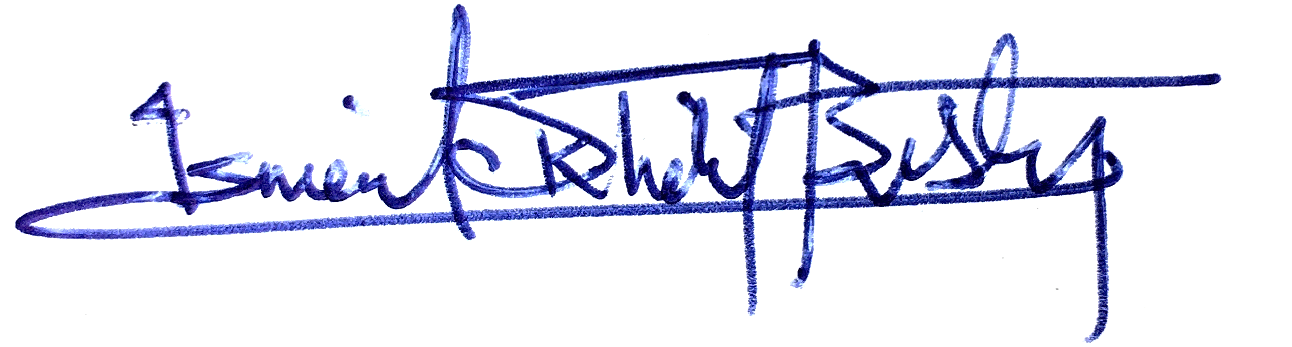
2023 ACM/IEEE Workshop on Machine Learning for CAD
FPGA Macro Placement Contest
Fifth Place
Chinese University of Hong Kong
CUMP-Placer
Yuan Pu, Lancheng Zhou, Mingjun Li, Yuhao Ji, Tinghuan Chen, & Bei Yu
Andrew Kahng & Husam Amrouch Jiang Hu Ismail Bustany
General Chairs Program Chair Contest Chair

Slide 42
2023 ACM/IEEE Workshop on Machine Learning for CAD
FPGA Macro Placement Contest
Fourth Place
Texas A&M University
TAMU-Placer
Hailiang Hu, Donghao Fang, Yishuang Lin, Jianfeng Song, & Jiang Hu
Andrew Kahng & Husam Amrouch Jiang Hu Ismail Bustany
General Chairs Program Chair Contest Chair

Slide 43
2023 ACM/IEEE Workshop on Machine Learning for CAD
FPGA Macro Placement Contest
Third Place
Chinese University of Hong Kong
CUMPLE-Placer
Qin Luo, Xinshi Zang, Qijing Wang, Fangzhou Wang, & Evangeline Young
Andrew Kahng & Husam Amrouch Jiang Hu Ismail Bustany
General Chairs Program Chair Contest Chair

Slide 44
2023 ACM/IEEE Workshop on Machine Learning for CAD
FPGA Macro Placement Contest
Second* Place
Peking University
MPKU-Placer
Jing Mai, Jiarui Wang, Xun Jiang, Yifan Chen, Zizheng Guo, & Yibo Lin
Andrew Kahng & Husam Amrouch Jiang Hu Ismail Bustany
General Chairs Program Chair Contest Chair

Slide 45
2023 ACM/IEEE Workshop on Machine Learning for CAD
FPGA Macro Placement Contest
First* Place
University of Texas at Austin
UTDA-Placer
Zhili Xiong, Rachel S. Rajarathnam, Zhixing Jiang, Hanqing Zhu, & David Pan
Andrew Kahng & Husam Amrouch Jiang Hu Ismail Bustany
General Chairs Program Chair Contest Chair

Slide 46
2023 ACM/IEEE Workshop on Machine Learning for CAD
FPGA Macro Placement Contest
First* Place
Southeast University
SEU-Placer
Hao Gu, Jian Gu, Yuxian Yue, Ziran Zhu, Jun Yang, & Jianli Chen
Andrew Kahng & Husam Amrouch Jiang Hu Ismail Bustany
General Chairs Program Chair Contest Chair

